Slide 1


Slide 2
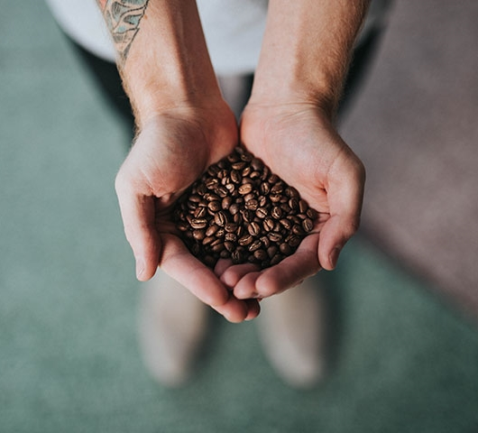

Divider slide
Unlocking the Starbucks Location Strategy
CHRIS TRAN
EMIL RODULFO
TIM BESAW

Slide 3
QUESTIONS
As a popular domestic brand, is Starbucks prevalent across the entire United States?
Does Starbucks offer the same appeal globally?
Are we able to find trends for existing locations using basic census data?
Are we able to determine where a new Starbucks location may open in Greater Orlando?

Slide 4
DATA SOURCES
Starbucks Locations Worldwide
https://www.kaggle.com/starbucks/store-locations
US Census
https://www.census.gov/data/developers/data-sets.html
Greater Orlando Zip / Area
https://www.bestplaces.net/find/zip.aspx?msa=36740&st=fl
Starbucks Company Timeline
https://www.starbucks.com/about-us/company-information/starbucks-company-timeline

Slide 5
PRESENTATION OVERVIEW
Global Summary
United States Overview
Florida Rundown
Greater Orlando Analysis
Conclusion

Slide 6
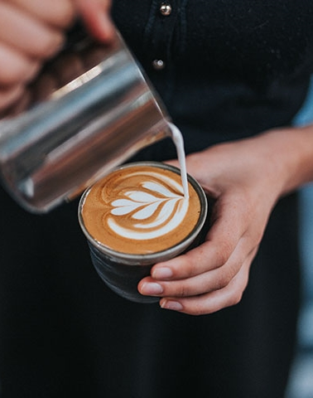
Global Summary

Slide 7
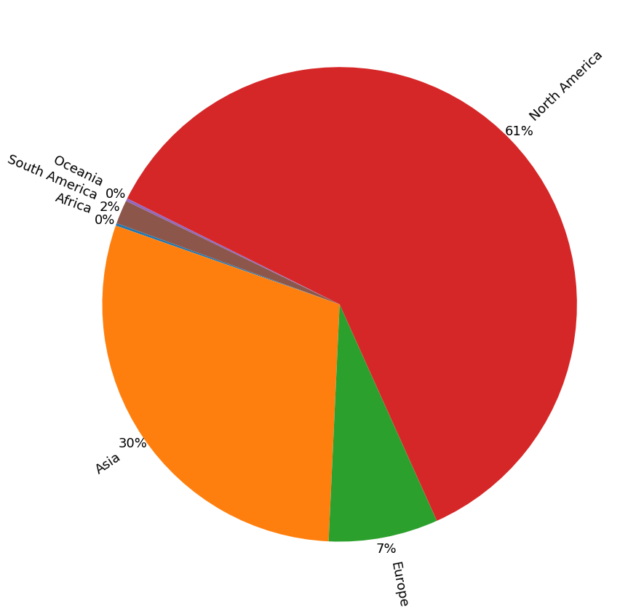
Global Starbucks Locations

Slide 8
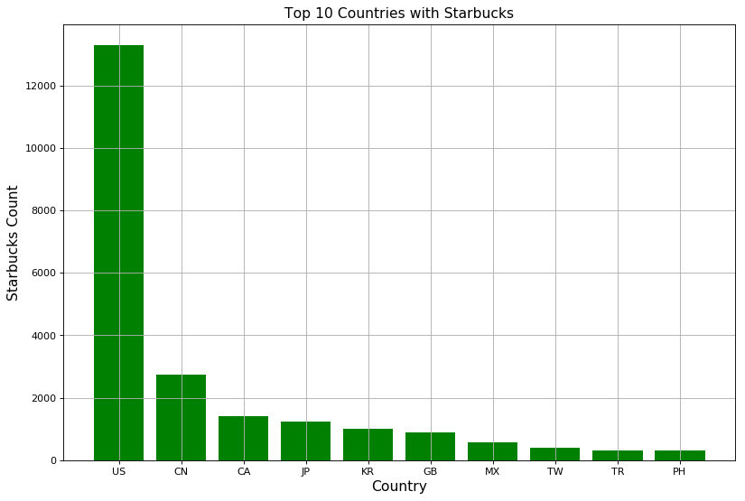
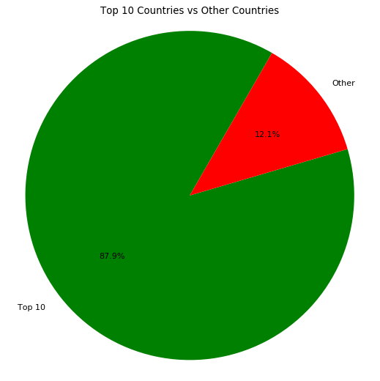
Top 10 Countries Globally

Slide 9
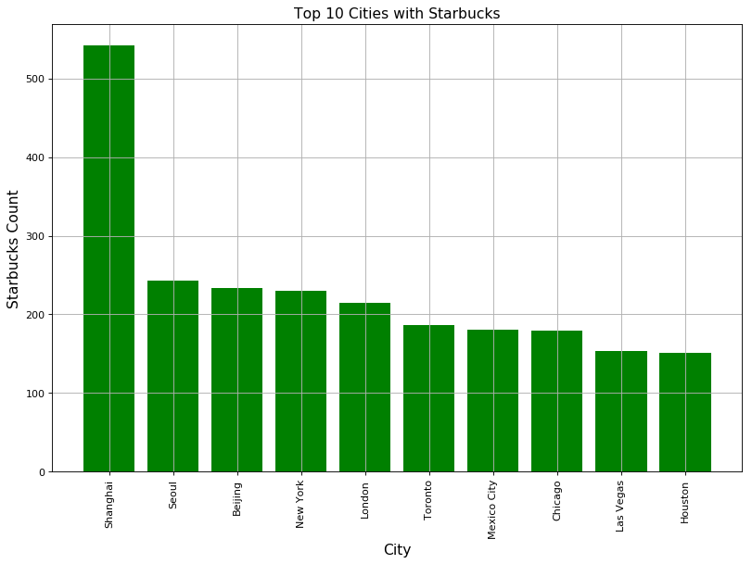
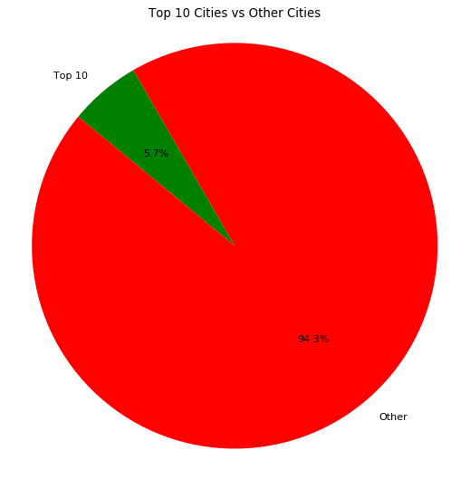
Top 10 Cities Globally

Slide 10
United States Overview

Slide 11
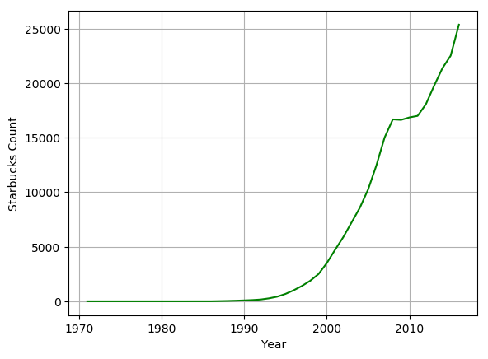
Starbucks Timeline

Slide 12
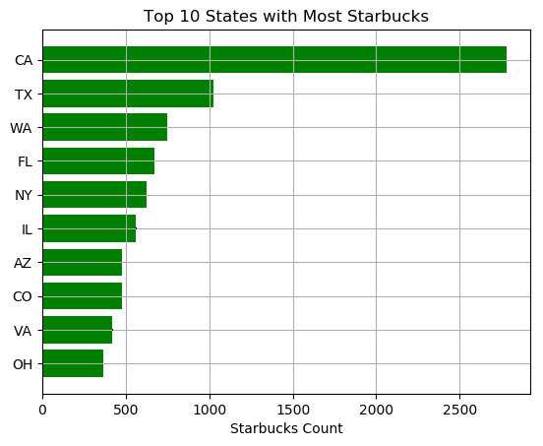
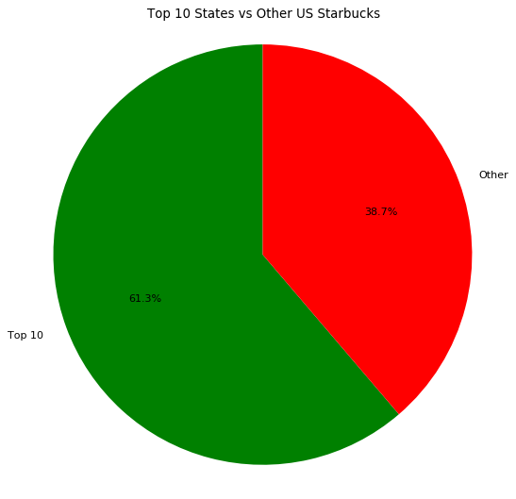
Top 10 States

Slide 13
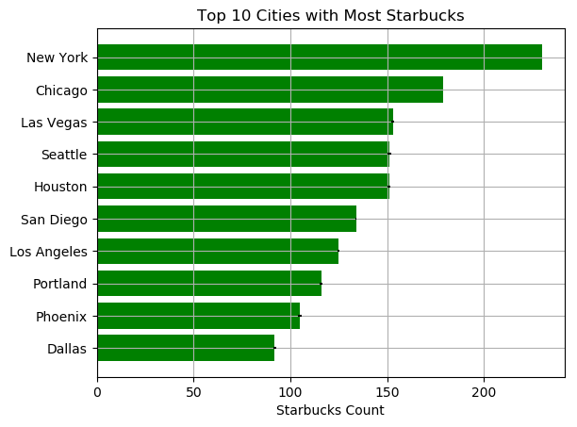
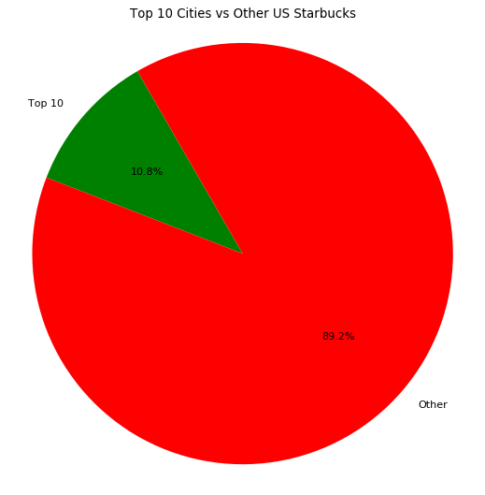
Top 10 Cities

Slide 14
Florida Rundown

Slide 15
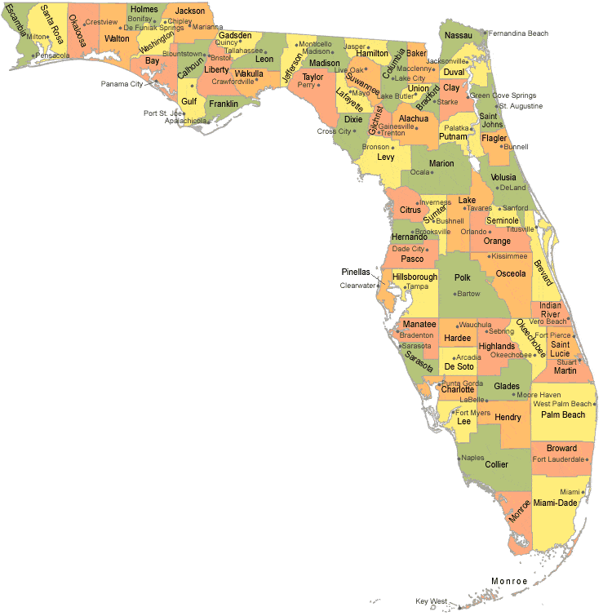
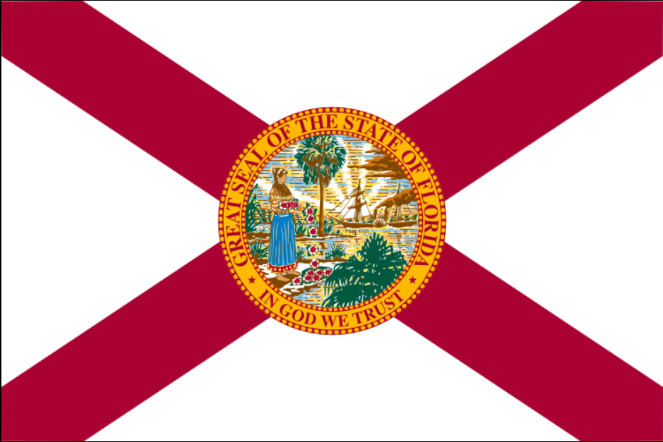
Florida Zip Code Census Data
Total Zip Codes | 969
Total Population | 19,932,688
Median Age (Avg) | 42.06
Per Capita Income (Avg) | $27,598.07
Poverty Rate (Avg) | 15.75 %
Total Starbucks | 660

Slide 16
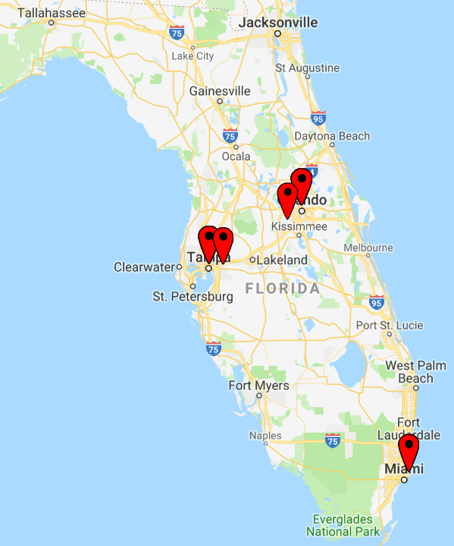
Florida Top 5 Zip Codes
Zip Code | Area | Starbucks Count
33607 | Tampa | 11
32819 | Dr. Phillips / Bay Hill / Tangelo Park | 11
33139 | Miami Beach | 8
33511 | Brandon / Riverview / Hillsborough | 6
32830 | Lake Buena Vista | 6

Slide 17
Greater Orlando Analysis

Slide 18
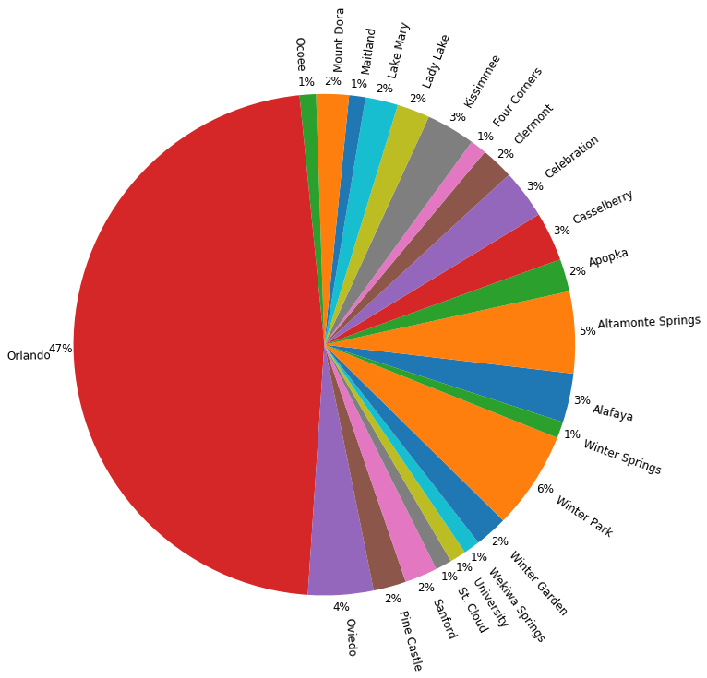
Greater Orlando Starbucks Locations by Area

Slide 19
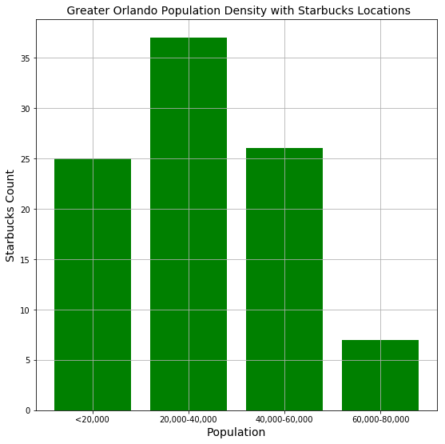
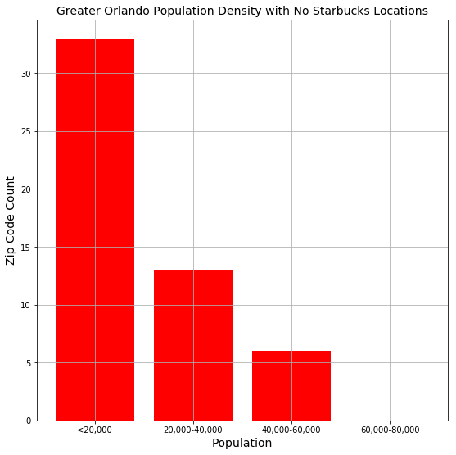
Population Analysis

Slide 20
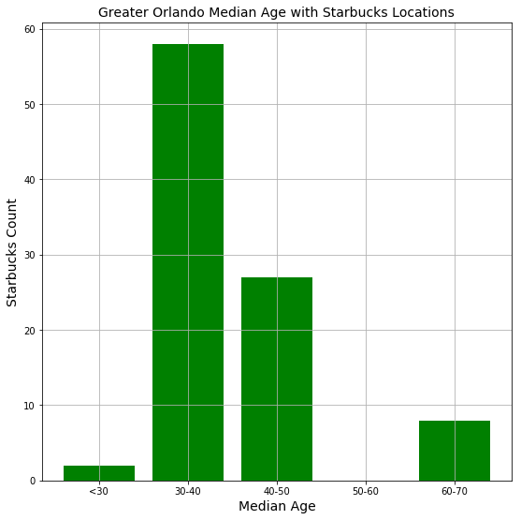
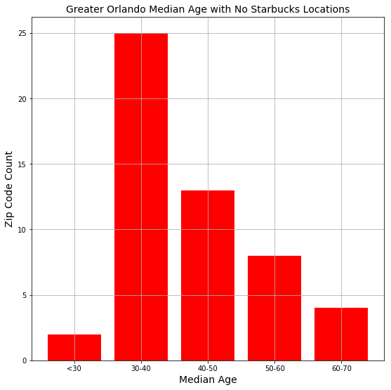
Median Age Analysis

Slide 21
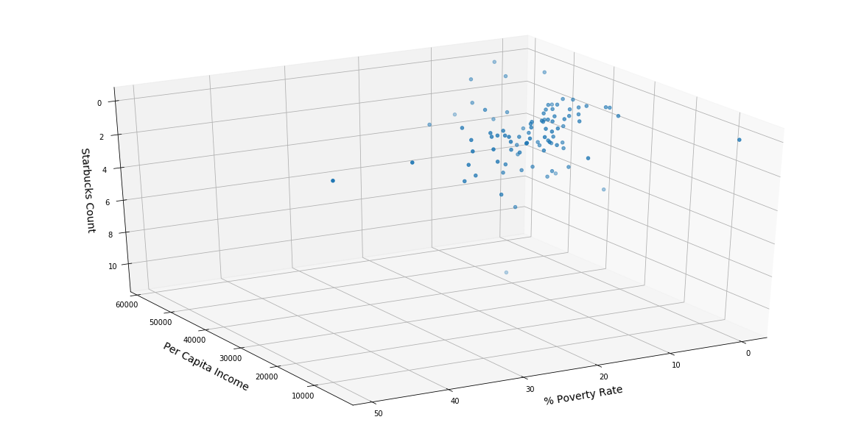
Per Capita Income & Poverty Rate vs Greater Orlando Starbucks Locations

Slide 22
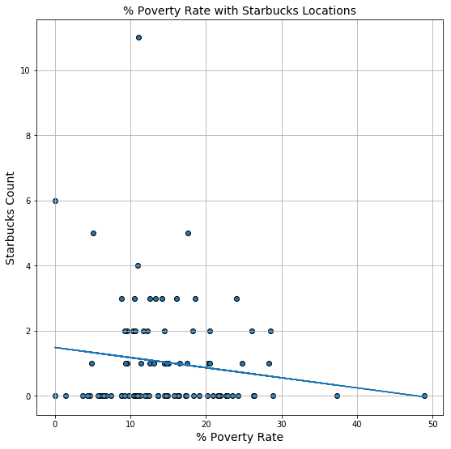
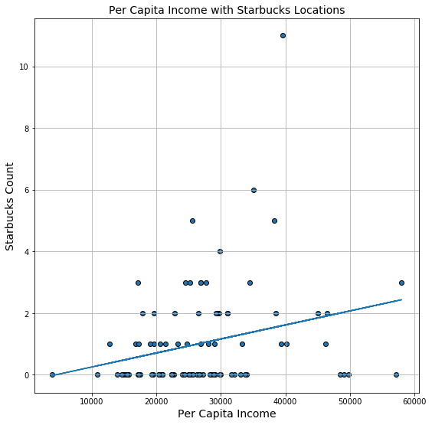
Per Capita Income & Poverty Rate vs Greater Orlando Starbucks Locations

Slide 23
Conclusion

Slide 24
Prospective Search Variables
Population | Median Age | Per Capita Income | Poverty Rate
> 20,000 | 30-40 | > $20,000 | < 20%
Greater Orlando Prospective Zip Codes
Zip Code | Area | Population | Median Age | Per Capita Income | Poverty Rate
32824 | Meadow Woods | 41,857 | 35.8 | 20,981 | 16.19 %
32829 | Orlando | 21,156 | 33.5 | 24,322 | 11.88 %
32832 | Orlando | 21,413 | 31.6 | 29,133 | 6.23%
34772 | St. Cloud | 29,182 | 37.0 | 22,336 | 10.95 %
34786 | Lake Butler | 38,249 | 35.2 | 49,054 | 6.47 %

Slide 25

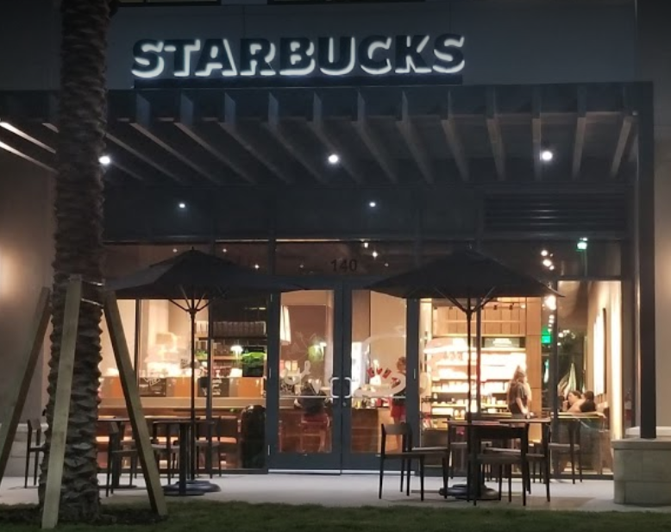
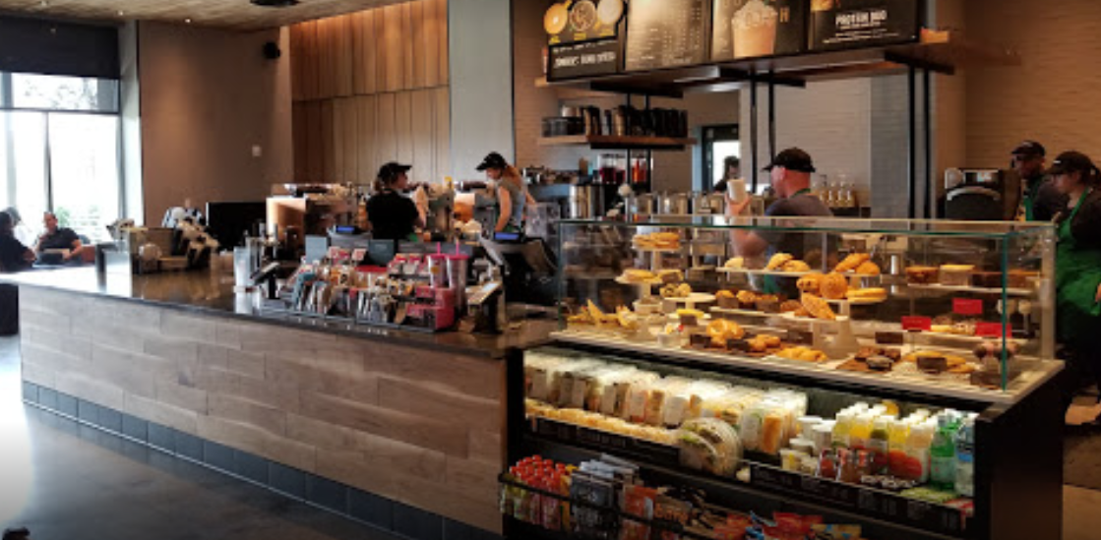
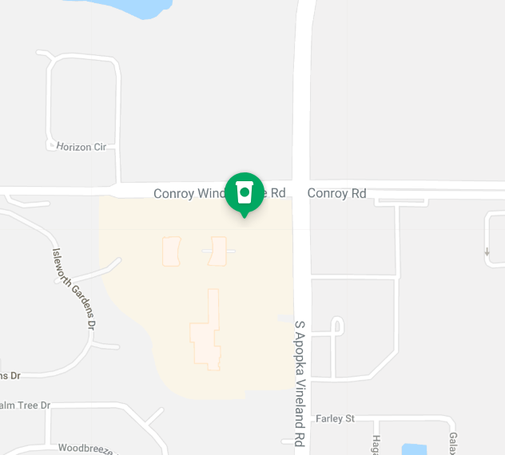
9100 Conroy Windermere Rd Suite 140, Windermere, FL 34786

Slide 26
Thank You
CHRIS TRAN
EMIL RODULFO
TIM BESAW

